Slide 1

Autonomous Roverbot using Scene Analysis
CS-022 CS-037 CS-105, Batch 2002-2003
Computer & Information Systems

Slide 2

Motivation Behind the Project
Autonomous RoverBot using Scene Analysis is an ambitious project
It is a fine mix of Creative Thinking, Logistics, Modeling and Programming
The motivation behind building a Vision-based project was the Digital Image Processing Workshop by Dr. Uvais Qidwai at NED, in 2005

Slide 3
Computer Vision
Computer Vision is a broad and promising field of computing
The creativity in Computer Vision is only limited by our own intellect, so there is ample room for advancement ☺
Mathematics is actually nature in written form

Slide 4
Crude Project Idea
To acquire objects through Scene Analysis in live video
To track a desired object
Extract the object coordinates
Follow the object
Repeat the process

Slide 5
Project Applications
Missile tracking
Intelligent Surveillance
Military Spying
Tracking a fast moving ball in a cricket/baseball match (blimp)
Remote survey of terrains

Slide 6
Project Design
Simulink Modeling (part of MATLAB)
Video and Image Processing Toolbox/Blockset
Image Acquisition Toolbox
Signal Processing Toolbox
Digital IO interface for hardware interfacing
Analog s-video hardware interface

Slide 7
Project Overview
Analog Camera
Frame
Grabber
Video Frames
Track Original
Target
Filter Objects
Apply Optical
Flow
Determine new
Direction of
Roverbot
Calculate
Centroid
Send signal
To Interface
RoverBot

Slide 8
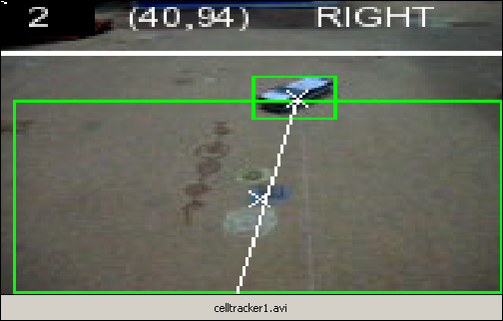
Video Illustration

Slide 9
The Interface
Circuitry

Slide 10
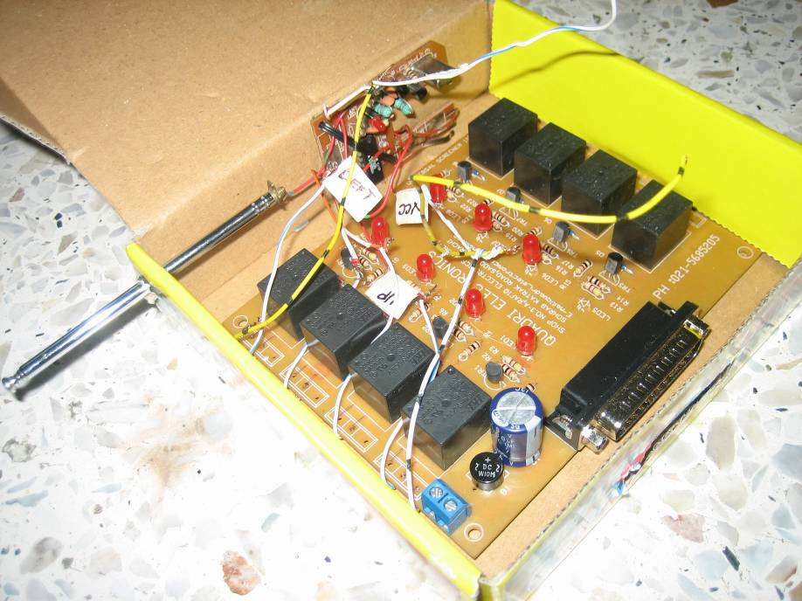
Remote Navigation Interface
Parallel Port Interface

Slide 11
The RoverBot

Slide 12
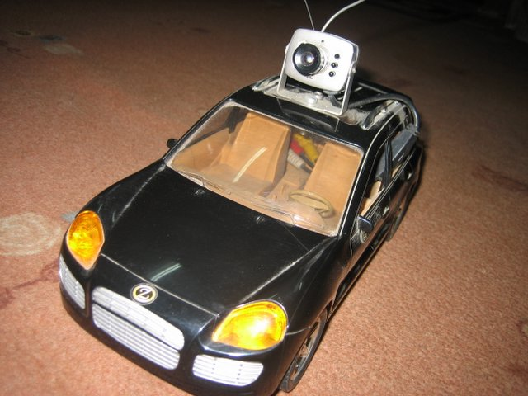
RoverBot
Wireless Camera
mounted on the rooftop

Slide 13
Scene Analysis

Slide 14
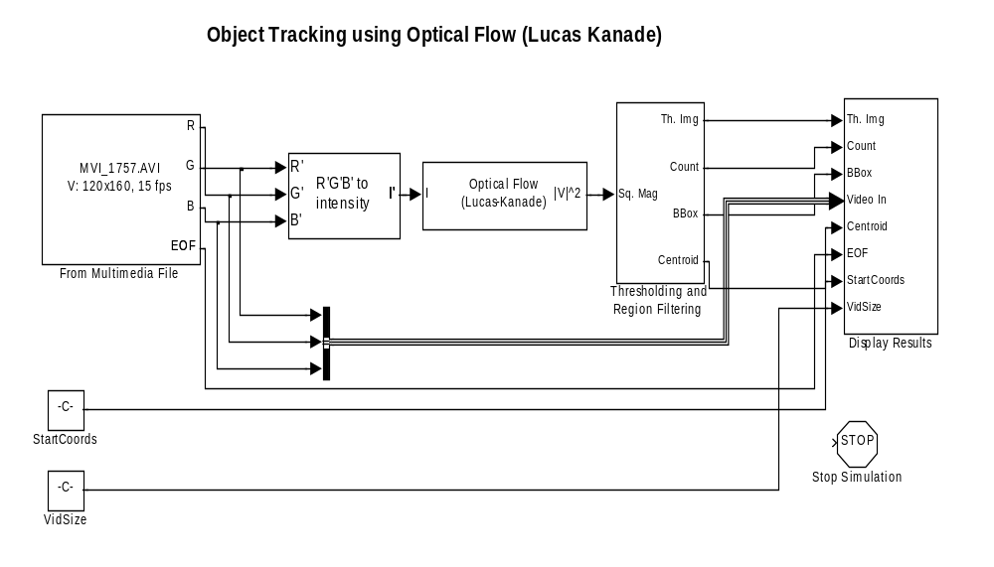
Top-Level Project Model
Video file input or live acquisition
The video is grabbed through the image
acquisition toolbox available in MATLAB
through a commonly available frame
grabber card and at rate of 15 frames
per second.
Optical Flow Algorithm
This block solves the optical flow problem using the Lucas Kanade method which is used to estimate motion.
Display Result Video
The parameters related to the current object being tracked and the motion of the vehicle are displayed in this block.
Filter out objects in scene
The regions which are in motion are filtered according to the amount of motion and size criteria.

Slide 15
Optical Flow
Optical flow is actually motion estimation
The estimation is in the form of vectors on a sequence of digital images
The solution to the optical flow problem is the determination of two velocity vector components, u and v, along the x and y axis respectively.
Two famous algorithms to compute optical flow: Lucas Kanade and Horn Schunck
Example of Optical follows on next slide

Slide 16
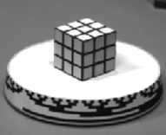
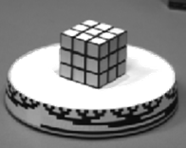
Optical Flow (Contd…)
Cube is Rotated

Slide 17
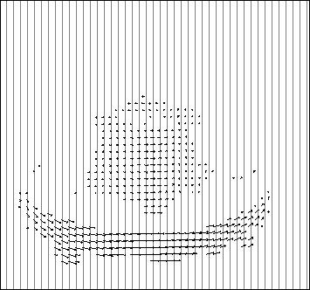
  Optical Flow Vectors

Slide 18
LK Research Analysis
LK | Velocity | Nth Frame | Relative Score | Comments
0.007 | 0.006 | 1 | 0.5 | Very Good
0.007 | 0.006 | 10 | 0.2 | Poor
0.007 | 0.006 | 5 | 0.275 | Too many objects
0.007 | 0.05 | 1 | 0.4 | Fair
0.007 | 0.1 | 1 | 0.2 | Fair
0.04 | 0.1 | 1 | 0.3 | -
0.03 | 0.1 | 1 | 0.35 | -
0.01 | 0.02 | 1 | 0.7 | Currently being used

Slide 19
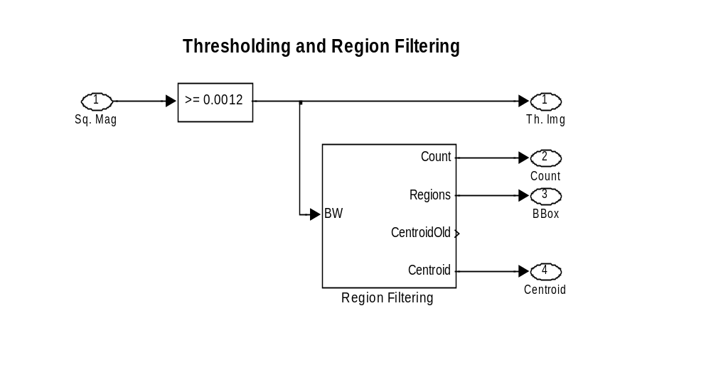
Thresholding
Thresholding
Region Filtering
Thresholding eliminates regions with a very small velocity.
Filters objects based on size.

Slide 20
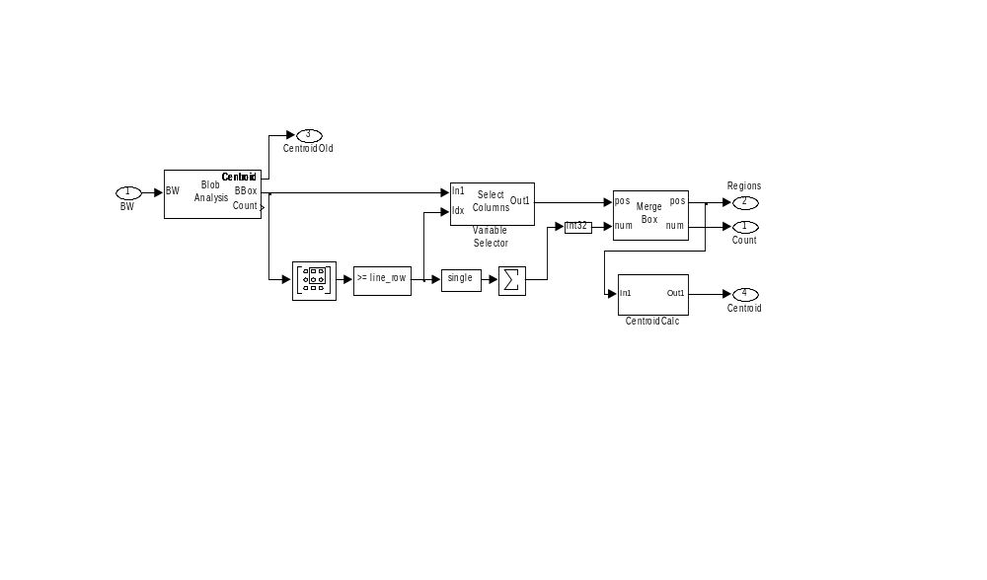
Region Filtering
Blob Analysis
Blob Analysis calculates bounding boxes of the moving regions and also filters out very small moving objects.
Centroid Calculation
Calculates centroid of moving objects, represented by bounding boxes.

Slide 21
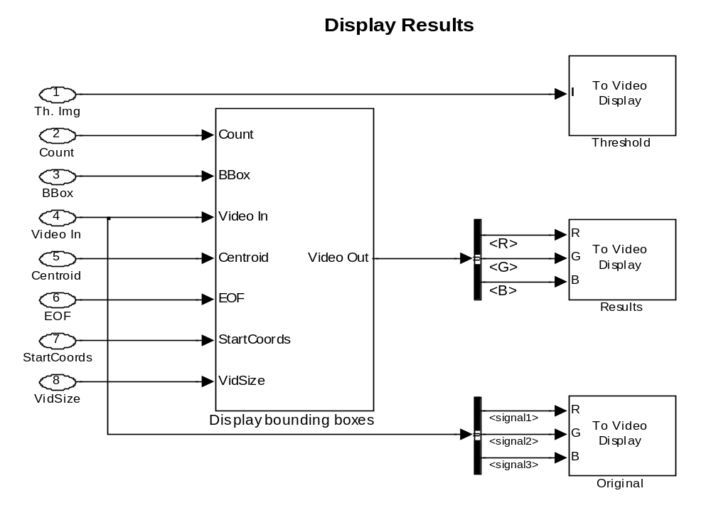
Results

Slide 22
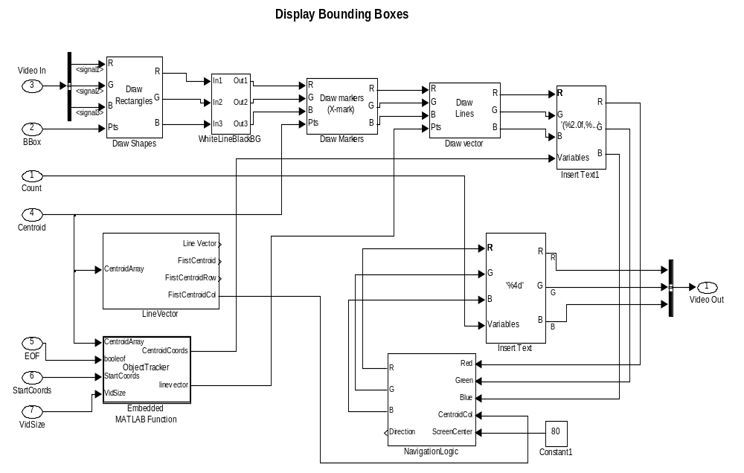
Object Tracking
Find the desired target
Contains the logic that filters out desired target from multiple detected objects based on the motion history of the target.
Navigation Logic
Contains the logic that navigates the roverbot to tracke the desired target. It is the roverbot motion command center.
Display parameters
No of objects
Bounding boxes
Centroid Marker
Centroid coordinates
Position vector

Slide 23
RoverBot Navigation

Slide 24
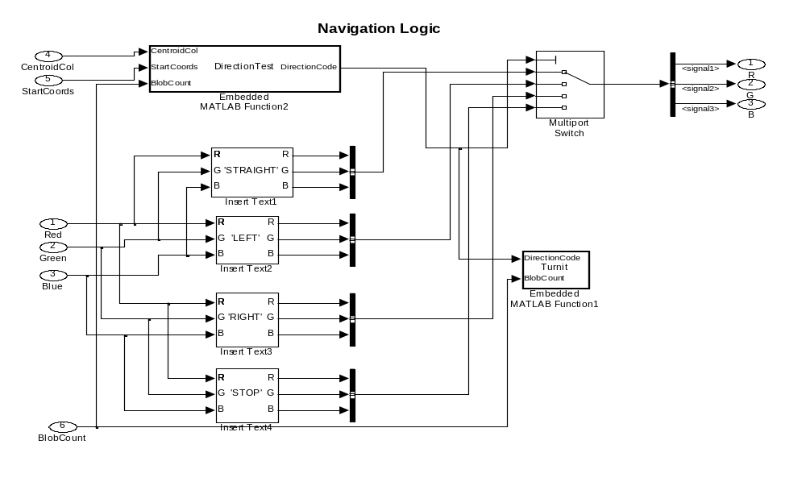
Navigation Logic

Slide 25
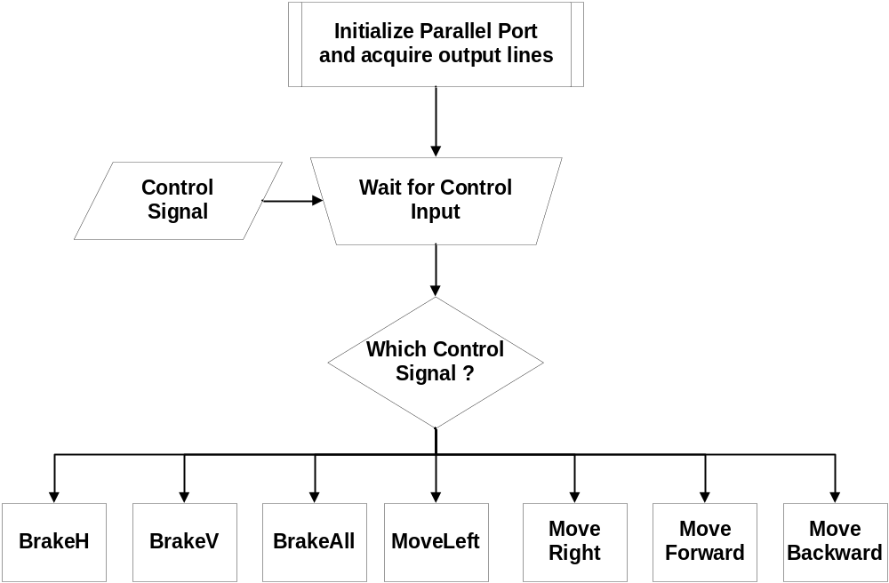
RoverBot Navigation Model

Slide 26
Future Enhancements

Slide 27
Future Enhancements
Smarter target tracking using Pattern matching
Obstacle avoidance using Haar classifiers
Distributed processing of frames over multiple processing nodes
360 degrees tracking using multiple cameras
Cooperation using multiple Robots, communicating with a base-station

Slide 28
Deploying Pattern Matching
Video Frame
Optical Flow
Pattern Match
Object
Found?
Object Tracking in Parallel
Object
Found?
Same
Objs?
yes
yes
If PM fails, supply new pattern using LK.
Conversely, if LK fails, start tracking object supplied by PM.
no
no
Acquire object
From PM
Acquire new image
From OF
Track

Slide 29
Deploying Haar Classifiers
Obtain images of known obstacles and generate patterns
Obtain classifiers from patterns
Train the algorithm using classifiers
Test and improve algorithm
Use the algorithm to identify and navigate around obstacles

Slide 30
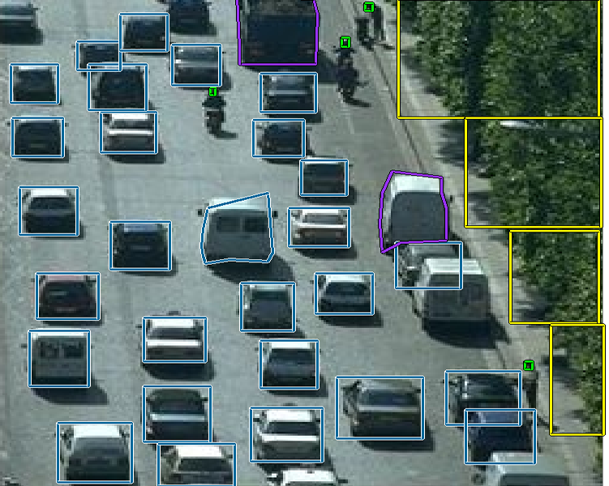
Example of Haar Classifiers

Slide 31
Distributed Processing
MATLAB Release 2006a and above offer a Distributed Processing Toolbox
Large images are broken into several blocks and assigned to separate nodes and partial results are generated
The final result is the intersection of all partial results
This allows for faster processing plus enhanced frame rate and high resolution video capture

Slide 32
Distributed Processing (Contd…)
Another aspect of distributed processing is multi resolution processing
The same processing on each frame is carried out at different resolutions and the partial results are intersected to obtain the final result.
This is known as Pyramidal Lucas Kanade algorithm (PyrLK)

Slide 33
Distributed Processing (Contd…)
Pattern Matching can also take advantage of distributed processing
Each pattern is matched at different magnifications and orientations in parallel
Also multiple patterns can be matched in parallel
The partial results are intersected

Slide 34
Thank You!
No difficult questions please! ☺

